Slide 1
WoT WG/IG TPAC – Day 1
Sebastian Kaebisch
14 September 2023

Slide 2
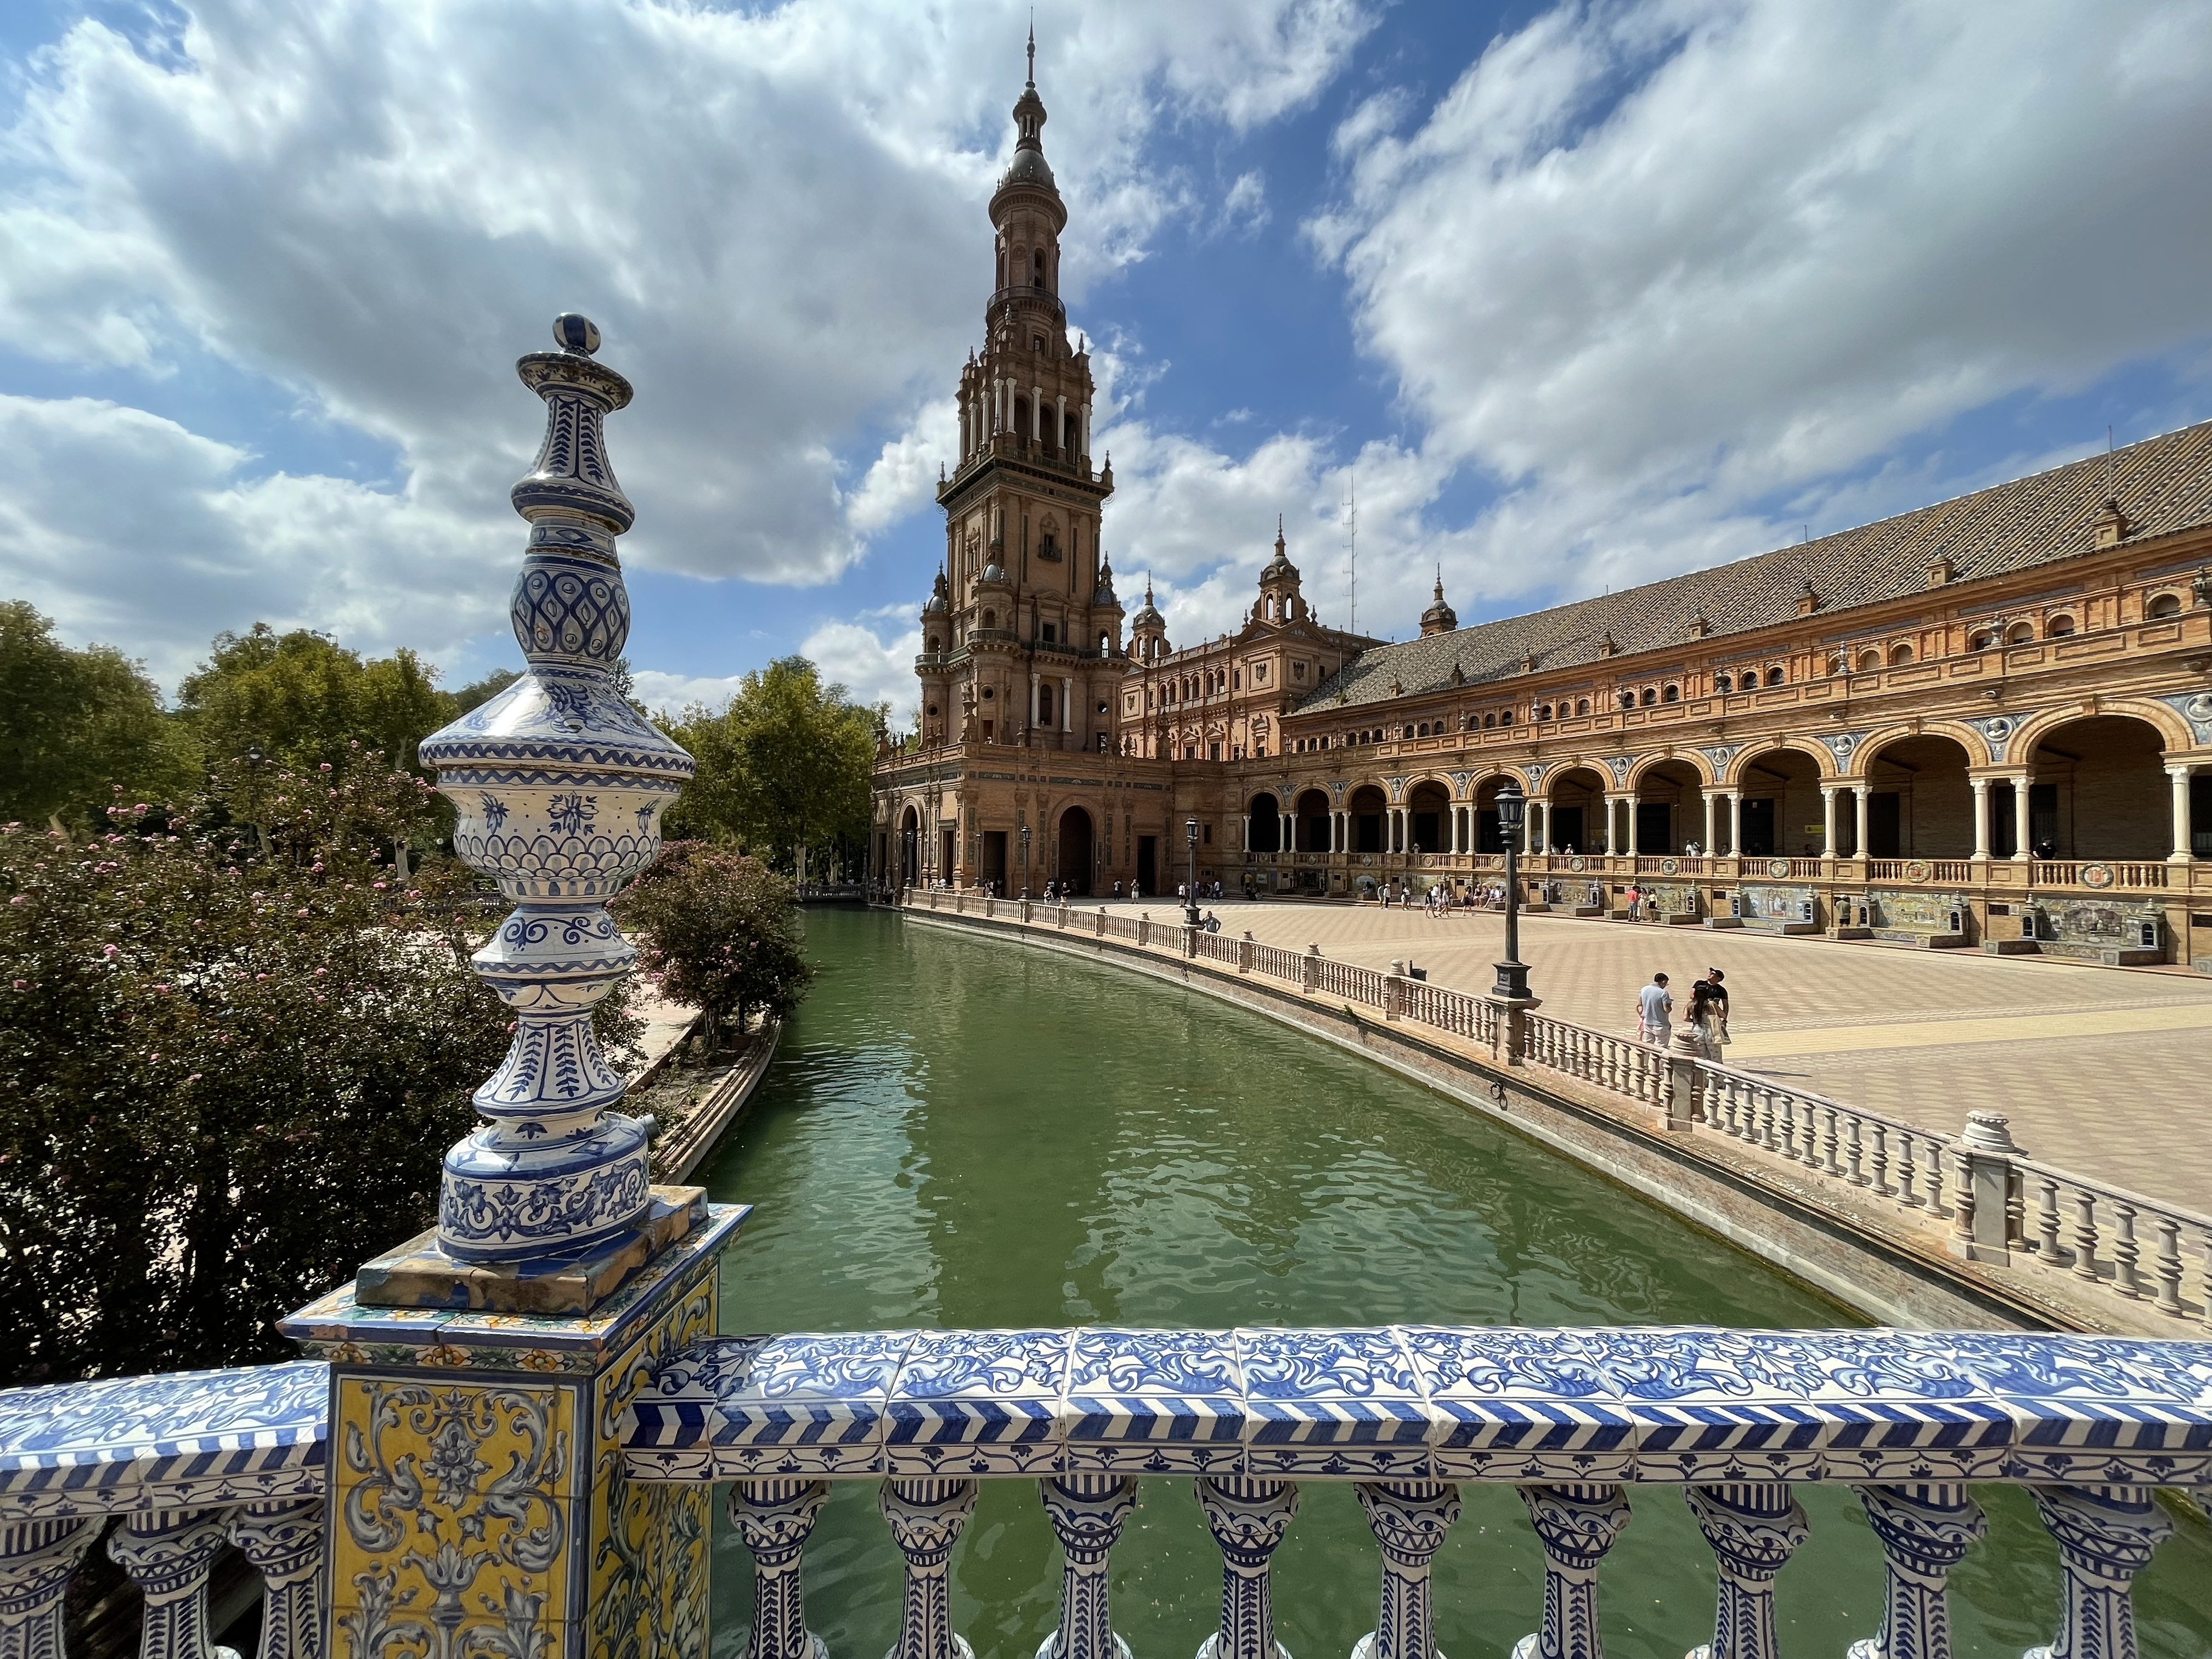
Welcome & Hello from Sevilla

Slide 3
Please Respect
Health Rules: https://www.w3.org/2022/09/TPAC/health.html
Code of Ethics and Professional Conduct: https://www.w3.org/Consortium/cepc/
Accessibilty and Internationalization
Respect the queue

Slide 4
IRC & WoT TPAC Resources & Minutes
IRC
please join #wot
https://irc.w3.org/?channels=wot
Minutes:
Cristiano 1st hour, Daniel 2nd hour, Mahda 3rd hour, Kaz 4th hour
Detailed agenda Presentations
https://github.com/w3c/wot/tree/main/PRESENTATIONS/2023-09-tpac
Please upload prior to your session
Please (also) export and upload a PDF version (PDF-only ok)

Slide 5
Topic Overview
Thursday (Sep 14) 14:30-18:30
WoT Overview & TPAC news
Use Case and Requirements Process
Thing Description and Bindings
Discovery
Accessibility - Joint Meeting
Friday (Sep 15) 14:30-18:30
Outreach (e.g., SDO collaboration)
Security and Privacy
WoT Profiles
WoT Architecture
New/Commercial Use Cases and Requirements - Joint Meeting
including visitors: PBG, MEIG, Second Screen, Devices and Sensors, WoT CG, WoT-JP CG, etc.
Wrap Up and Next Steps

Slide 6

Thursday Sept 12 (4h) TPAC Day 1
14:30-14:45 (15m) Opening, Introductions, Joint Session/Breakout reports (Sebastian)
14:45-15:30 (30m) Use Case and Requirements Process (McCool)
15:30-16:45 (1h15) TD and Bindings (Sebastian, Ege, Koster)
16:45-17:00 (15m) Break
17:00-17:25 (25m) Discovery (McCool)
17:25-17:30 (5min) Move to room Utrera (1st floor)
17:30-18:30 (1h) Accessibility (McCool) – Joint
After the meeting: Group Photo at terrace

Slide 7

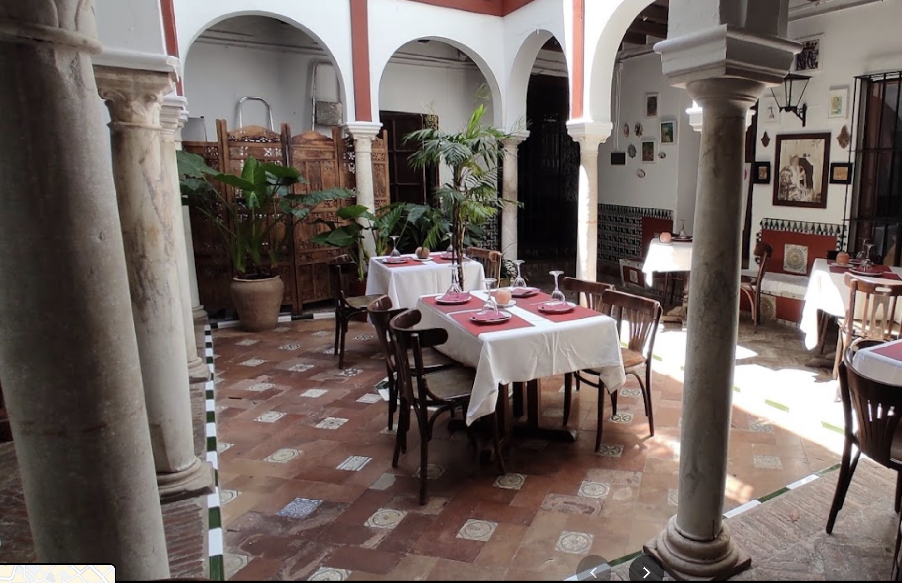
WoT Dinner Tonight
Meeting point:
Melia Seville at 7:30pm
Restaurant: 8pm
Restaurant: Corral del Agua http://corraldelagua.es/?lang=en https://goo.gl/maps/ZafraZzEX8NqiCha7
Notes:
https://goo.gl/maps/ZafraZzEX8NqiCha7

Slide 8




W3C WoT in a Nutshell
IoT Challenges:
heterogenous device landscape (sensors, actuators, communication protocols, data models, security constraints, …)
Time & cost-intensive IoT onboarding and application development
WoT WG goal: Adapting web paradigm to IoT and provide building blocks such as Thing Description (TD), API, Discovery, etc.
App
App
App
App
App
App
WoT API
WoT API
WoT API
{ properties, actions, events }
MQTT
KNX
TLV
ECHONET
Bearer
EXI
HTTP
OAUTH2
WS
XML
MQTT
KNX
TLV
ECHONET
Bearer
EXI
JSON
Modbus
CBOR
OPC-UA
API Key
HTTP
OAUTH2
CBOR
WS
XML
BACnet
AMQP
JSON
Modbus
BACnet
OPC-UA
API Key
AMQP
More details, please visit https://www.w3.org/WoT/documentation/

Slide 9
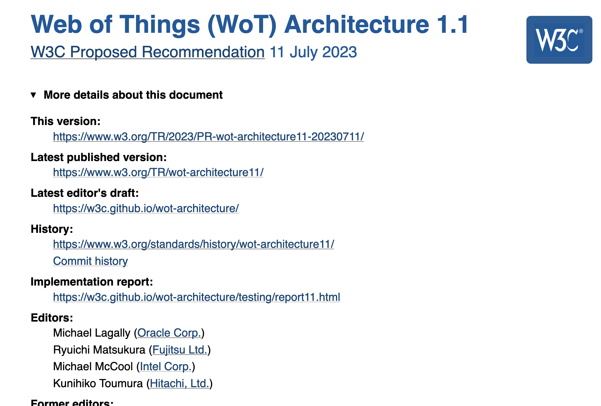
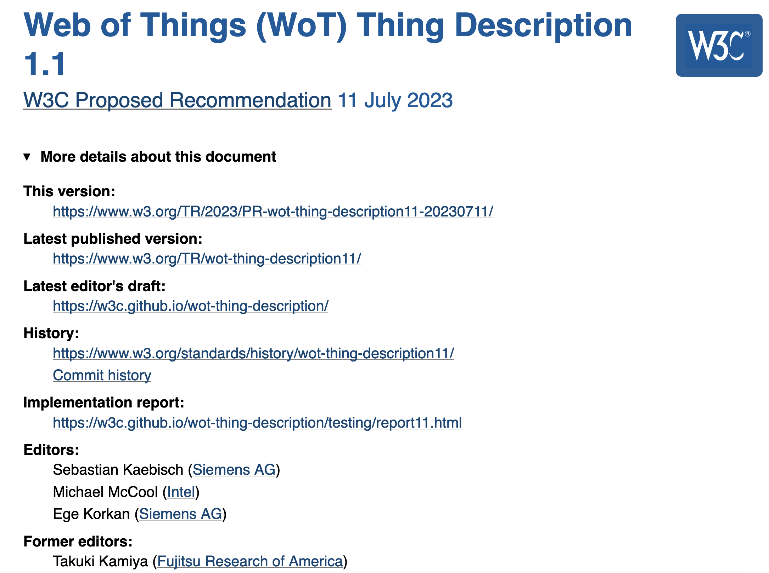
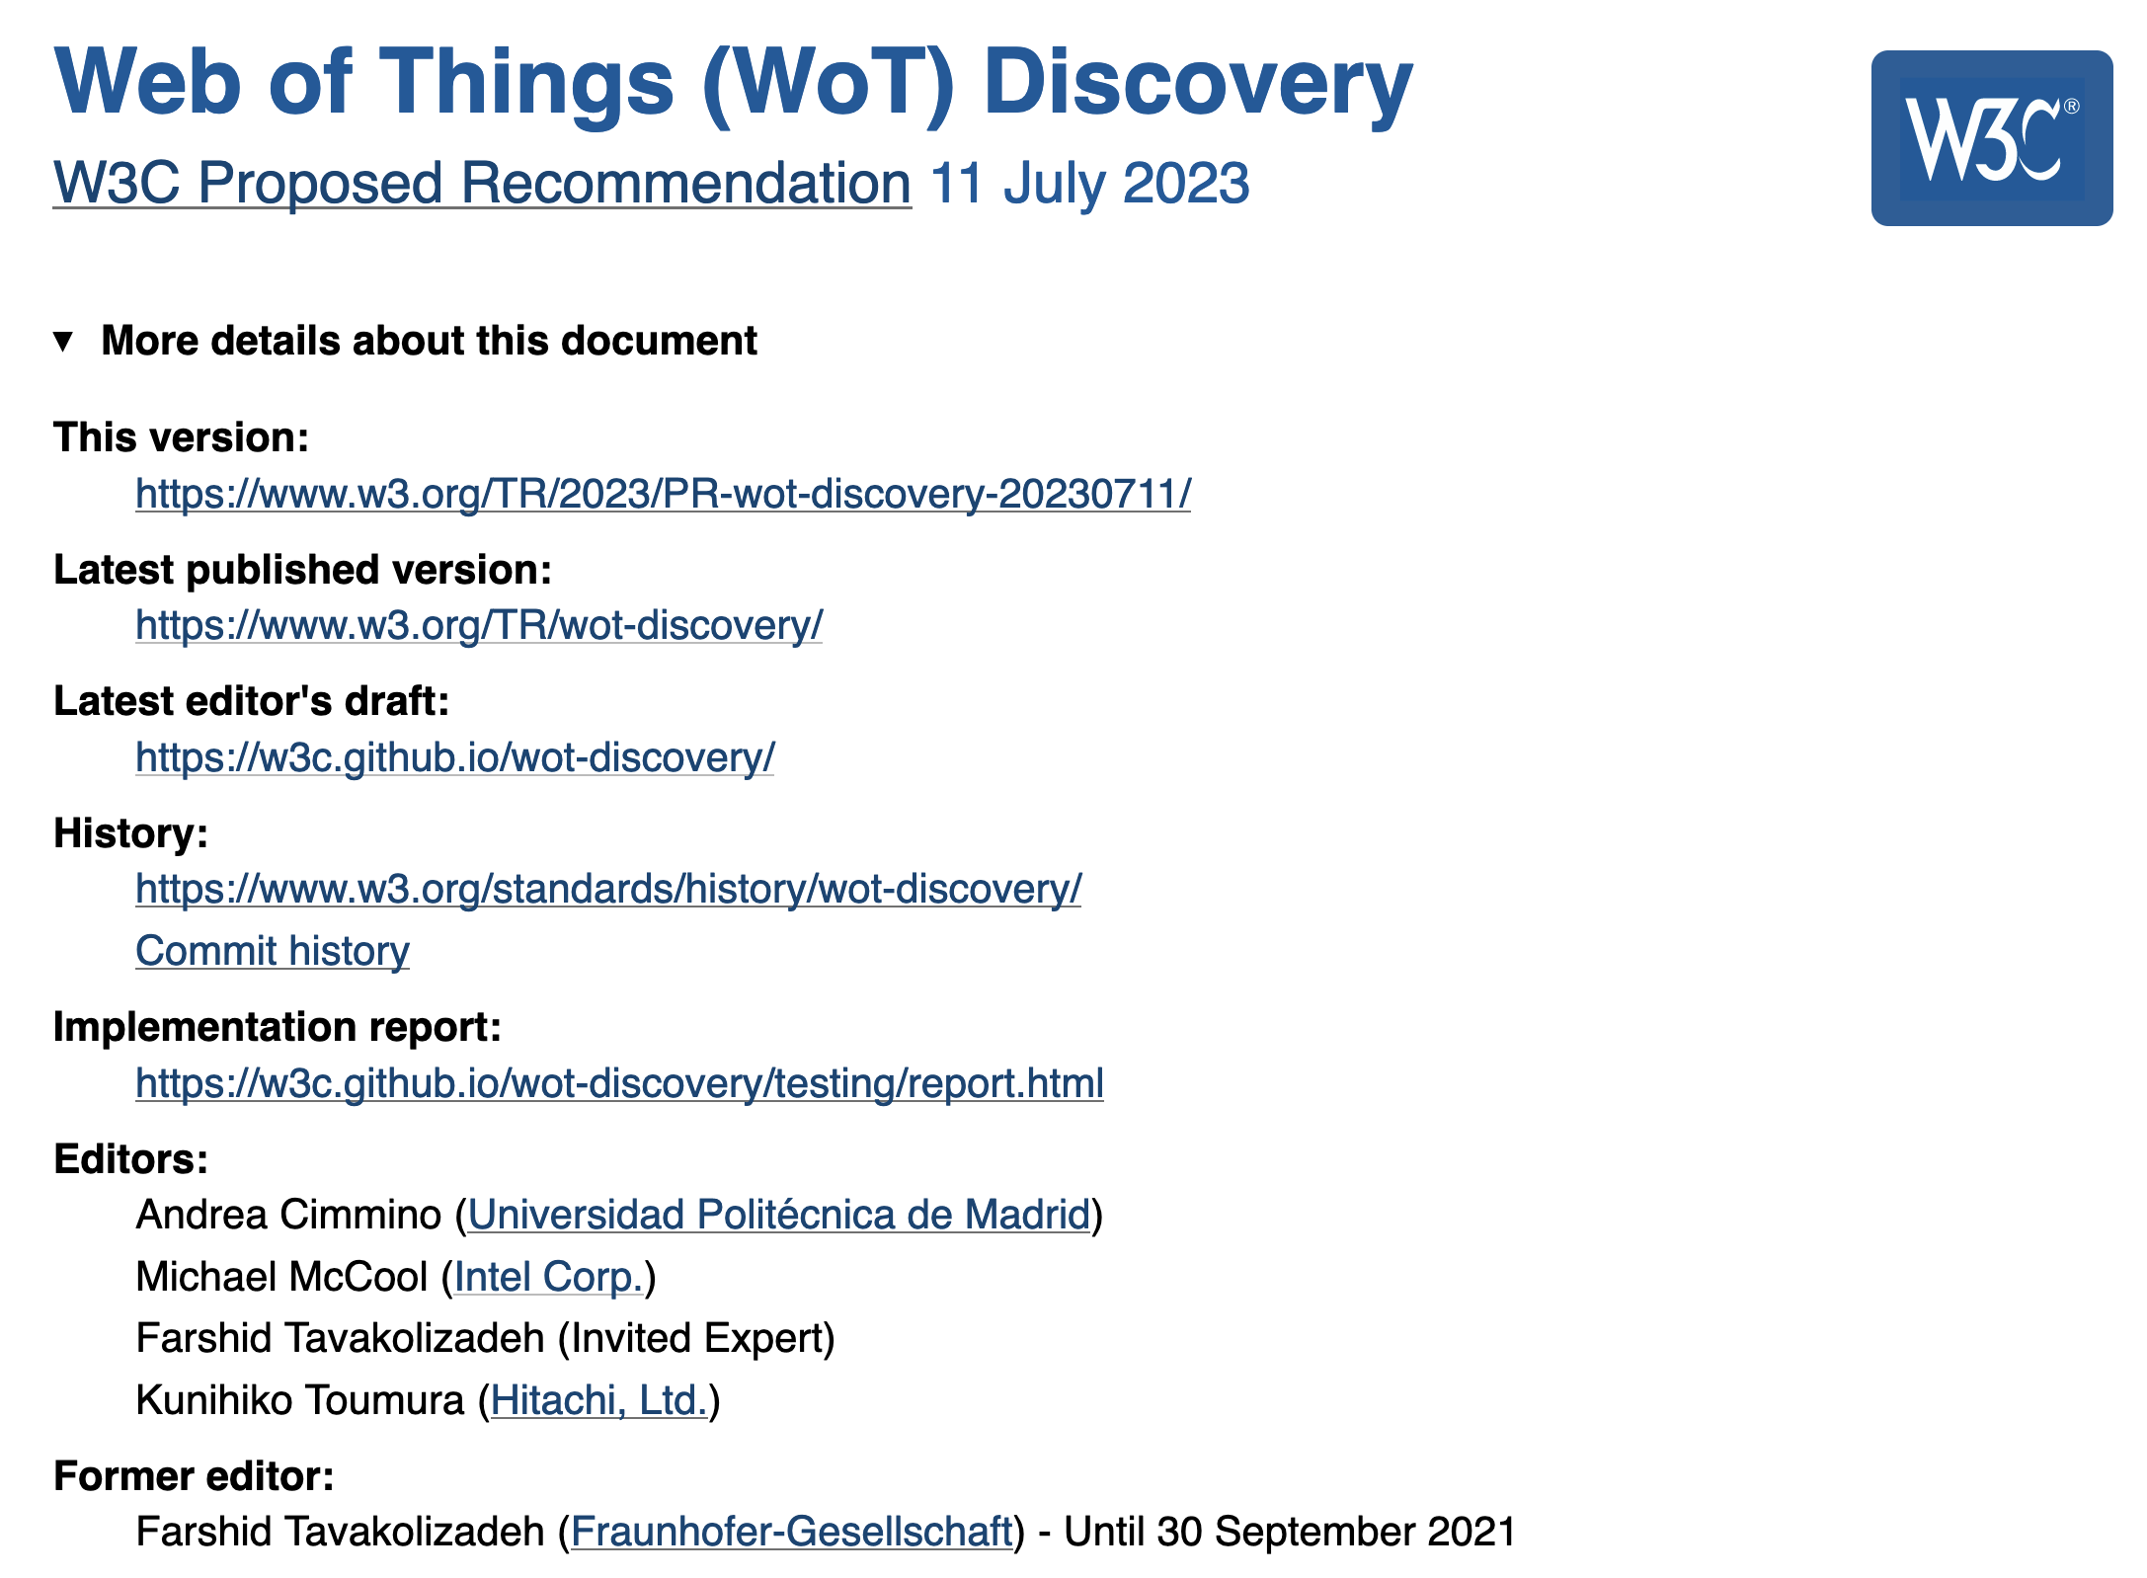
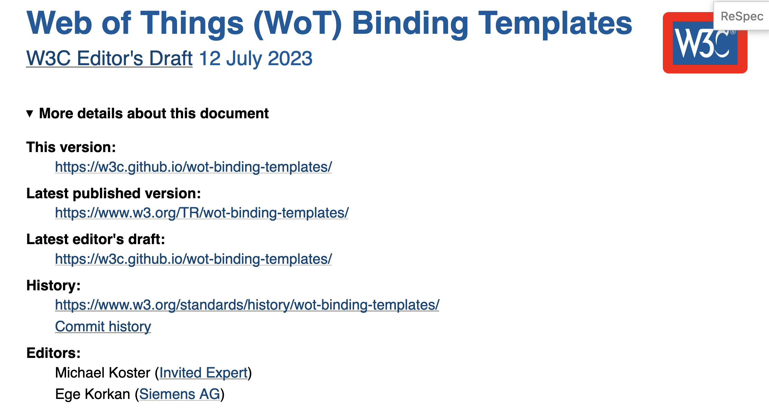
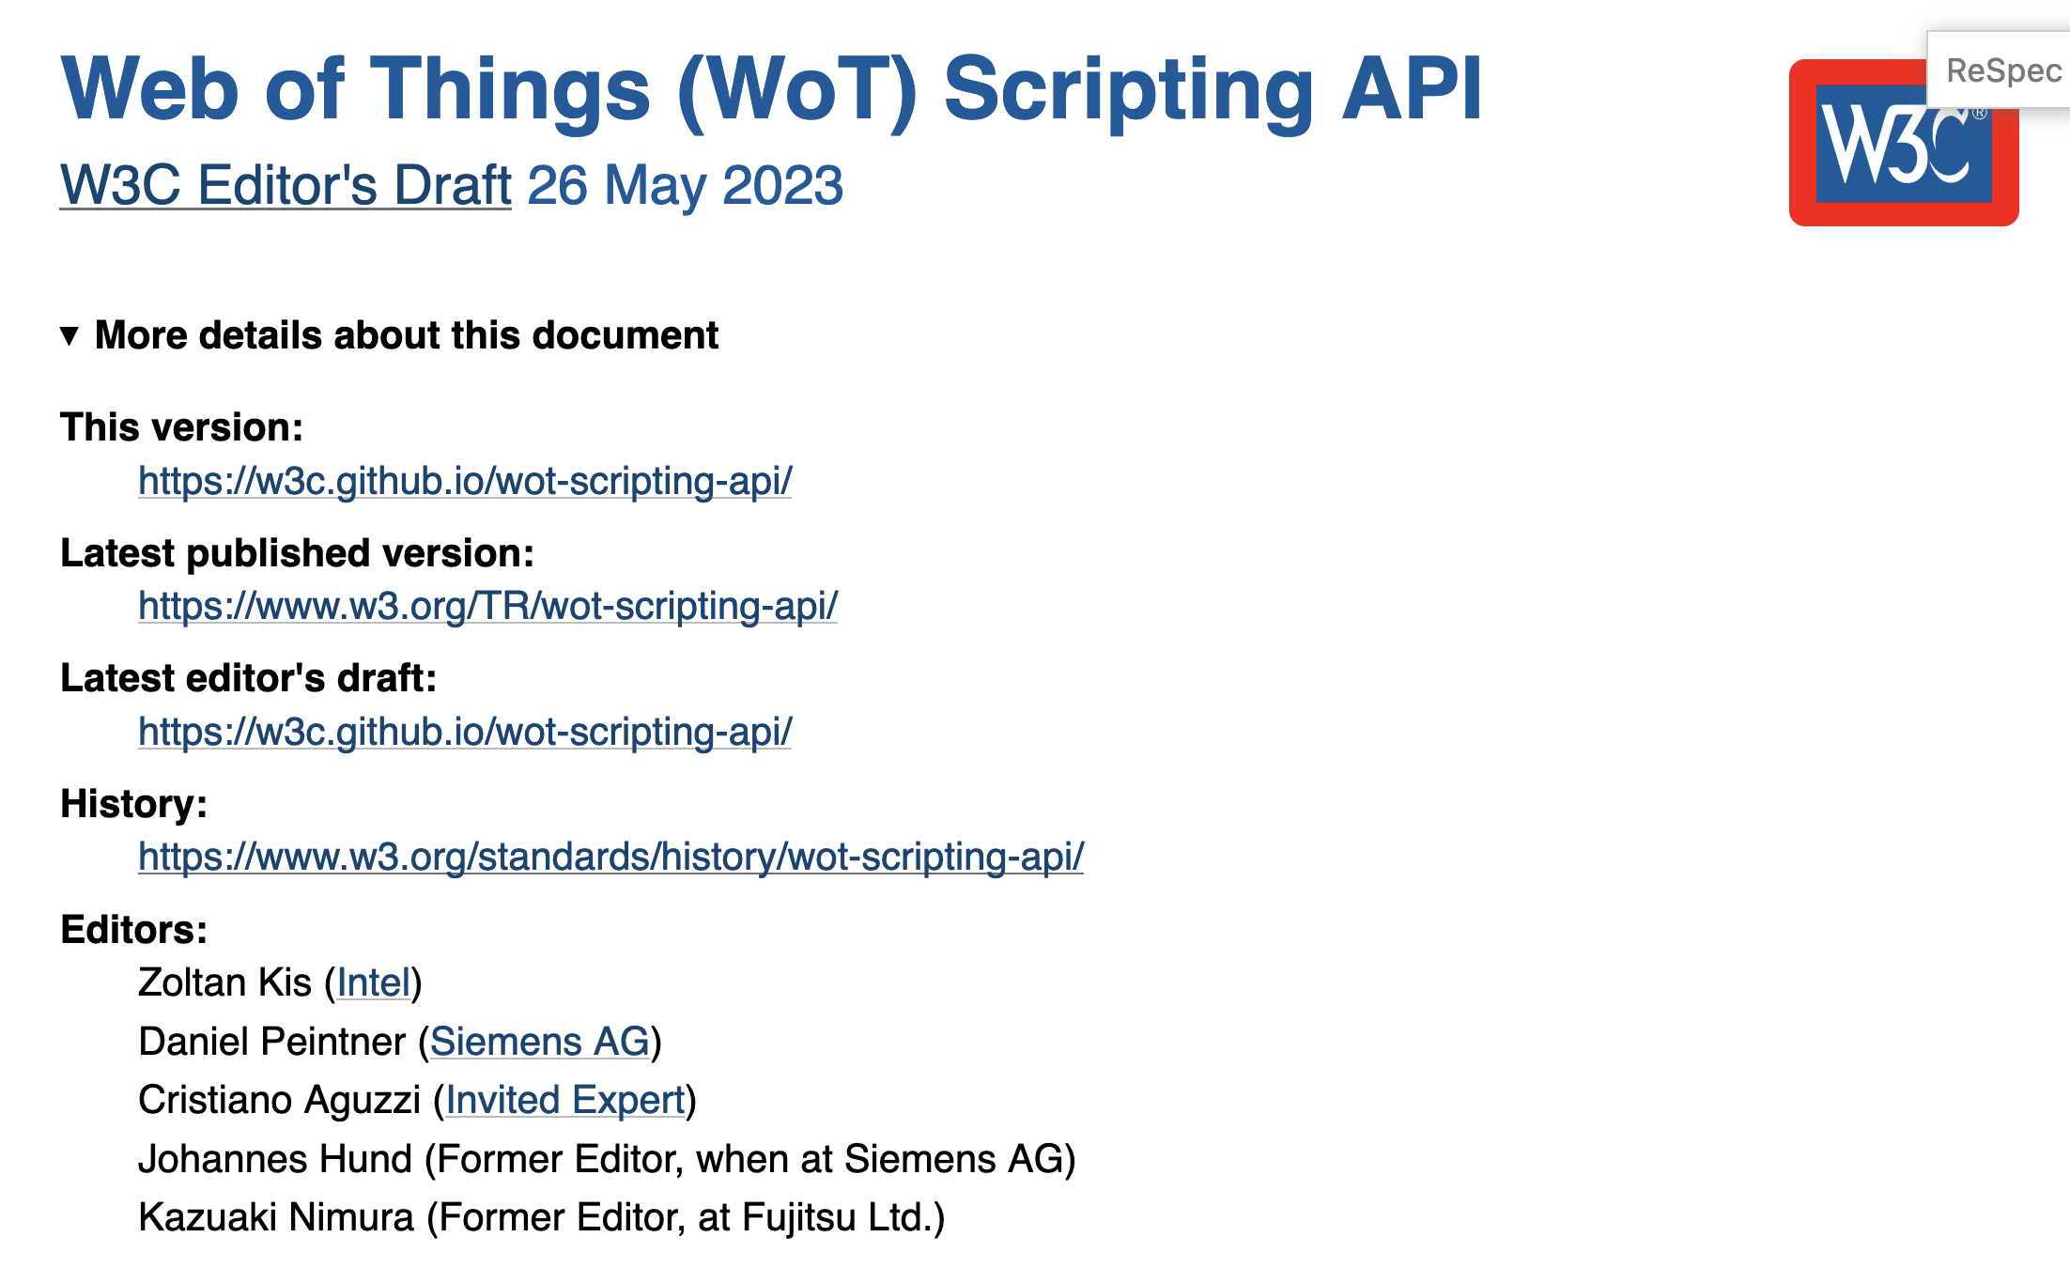
WoT New Deliverables
REC Track:
WoT Architecture 1.1
WoT Thing Description 1.1
WoT Discovery
Passed AC PR voting
Releasing RECs end of September
Note Track:
Updated WoT Scripting API
Updated WoT Binding Template
→ Publishing soon

Slide 10
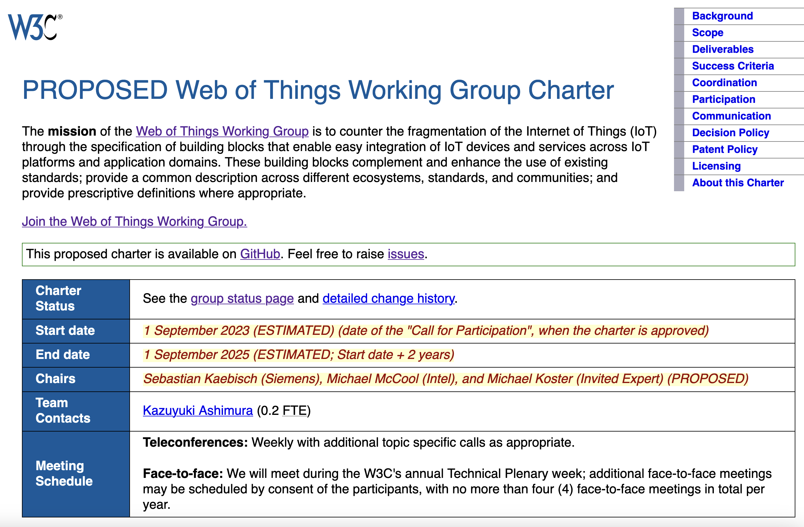
“WoT 2.0” Starting Soon
WoT charter next passed AC voting
Work on the new Charter begins in October
→ a good time to join the WG and become part of the WoT family
More details: https://www.w3.org/2023/08/wot-wg-2023-draft.html

Slide 11
Overview: TPAC Meetings (Joint, Breakouts, etc)
Monday:
Autonomous Agents on the Web (WebAgents) CG & Web of Things CG/WG joint meeting
JSON for Linking data WG, Web Of Thing WG, RDF Dataset Canonicalization and Hash Working Group Joint meeting
Wednesday (Breakout Sessions):
Web of Things Scenarios at Home Assistant
Web-based Digital Twins for Smart Cities
„You say Schemata, I say Schemas“
Thursday&Friday:
Web of Things CG

Slide 12
Resources and WG/IG Co-Chairs Contacts
https://www.w3.org/WoT
Dr. Michael McCool
Principal Engineer
Intel
Technology Pathfinding
michael.mccool@intel.com
Dr. Sebastian Kaebisch
Senior Key Expert
Siemens
Technology
sebastian.kaebisch@siemens.com

